Slide 1
Aim 1 Overview and Plan

Slide 2
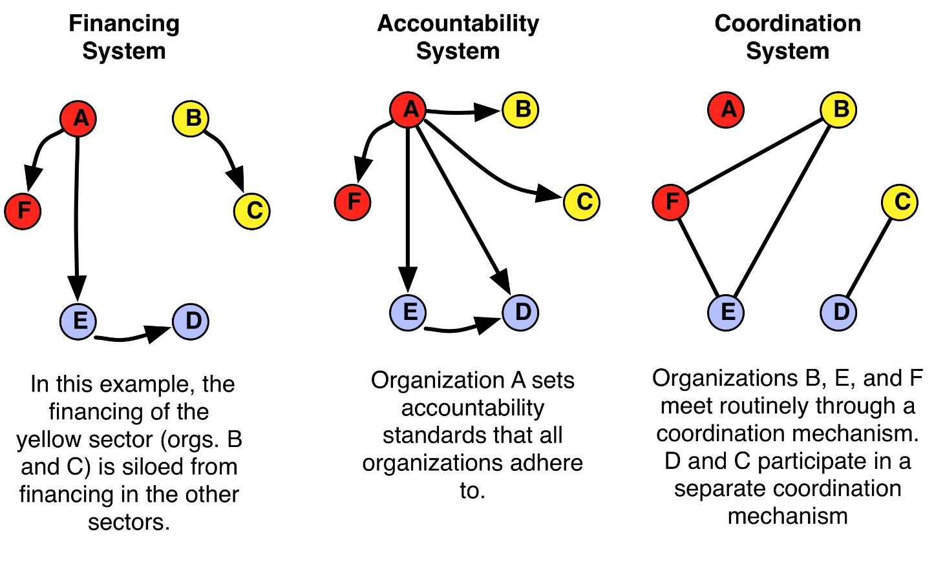
Aim 1: How has integration among the medical care, social services, and public health sectors changed as a result of CHT + All-Payer Waiver?

Slide 3
Where are we?
 | Accountability system | Coordination system | Financing system
Pre All-Payer Waiver | Currently reviewing documents | Prior coordination network data acquired | Collecting hospital 990 forms
Post All-Payer Waiver | Documents reviewed, draft system map created | Network survey to be fielded soon | Collecting hospital 990 forms

Slide 4
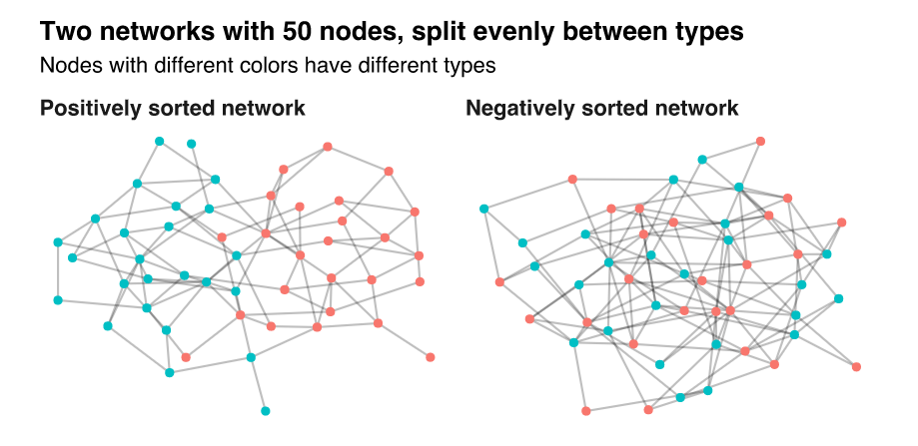
Did Community Networks Get More or Less “Sorted” Over Time?

Slide 5
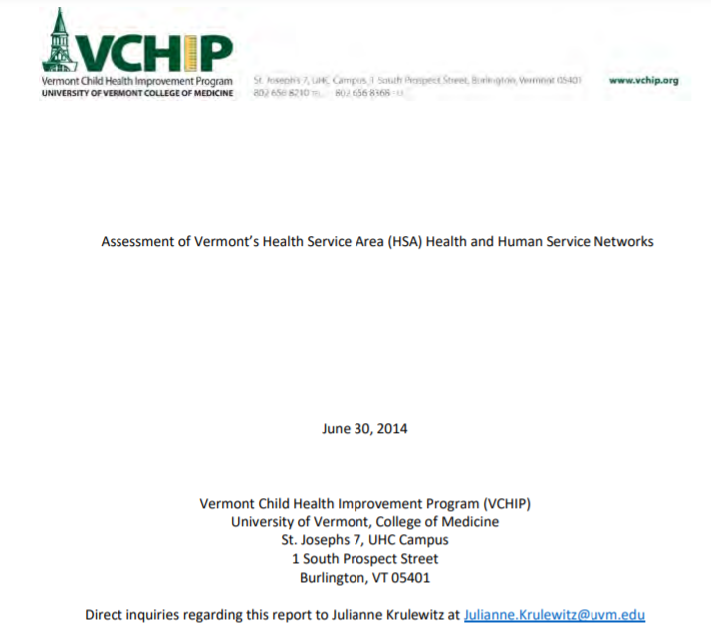

Prior 2014 and 2015 studies in VT

Slide 6
Survey Methodology
Organizations surveyed about connections to other organizations in their health service area
2-step process:
(1) Generate the list of relevant organizations (will describe more later)
(2) Survey all relevant organizations in each HSA about interactions with other organizations in that HSA

Slide 7
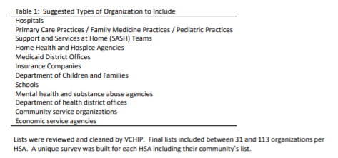
2014 List Development
Survey was sent to Blueprint PMs

Slide 8
2015 Organization Lists
 | Health Services | Public Health | Social Services | Total
Barre | 12 (63%) | 3 (16%) | 4 (21%) | 19
Brattleboro | 8 (29%) | 8 (29%) | 12 (43%) | 28
Burlington | 23 (74%) | 4 (13%) | 4 (13%) | 31
Middlebury | 11 (52%) | 3 (14%) | 7 (33%) | 21
Morrisville | 16 (76%) | 2 (10%) | 3 (14%) | 21
Newport | 7 (47%) | 3 (20%) | 5 (33%) | 15
Randolph | 5 (50%) | 3 (30%) | 2 (20%) | 10
Rutland | 16 (62%) | 6 (23%) | 4 (15%) | 26
Springfield | 10 (48%) | 6 (32%) | 15 (19%) | 31
St. Albans | 22 (71%) | 3 (10%) | 6 (19%) | 31
St. Johnsbury | 15 (42%) | 5 (14%) | 16 (44%) | 36
Upper Valley | 9 (90%) | 0 (0%) | 1 (10%) | 10

Slide 9
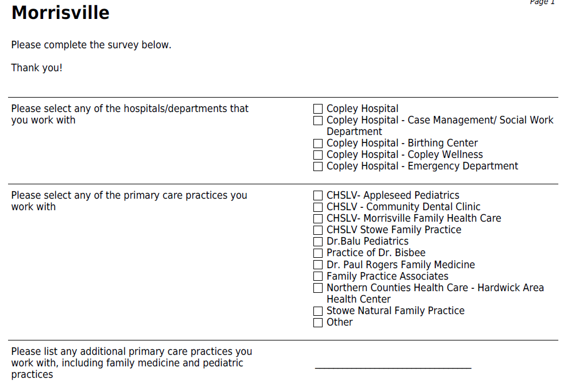
Planned 2021 Survey to Generate Lists of Orgs

Slide 10
Feedback
We plan to pre-populate lists with orgs included in 2014 and 2015 studies, are there any others we should include?

Slide 11
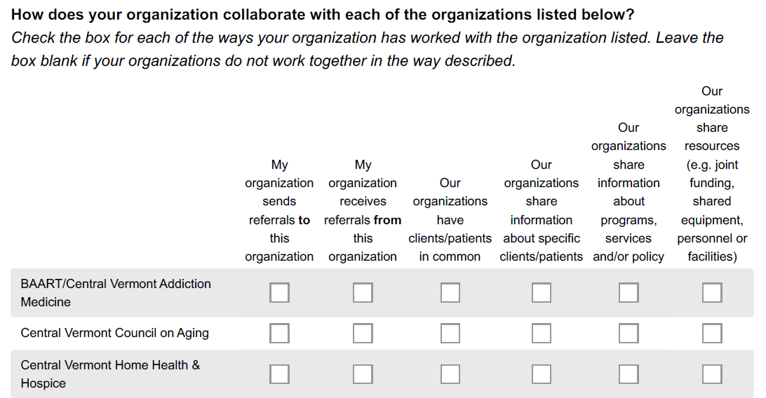
Step 2 Surveys Sent to ALL Listed Orgs in Each HSA

Slide 12
Possible Open Ended Qs (based on 2014 survey)
Please think about an instance where new or enhanced relationships between organizations (your organization and other health, social or economic services providers) have improved the health and well-being of people in your community. In a brief paragraph, please share the story of how your organizations worked together and what you achieved. (Do not give names or other identifying details). Note that responses to this question will be shared only if they are free of protected health information and any other personally identifying details.
If you have any additional thoughts about the Vermont Blueprint for Health, organizational collaboration, or working to improve individual and population health in your community, please share them here:
What else would you like to know?

Slide 13
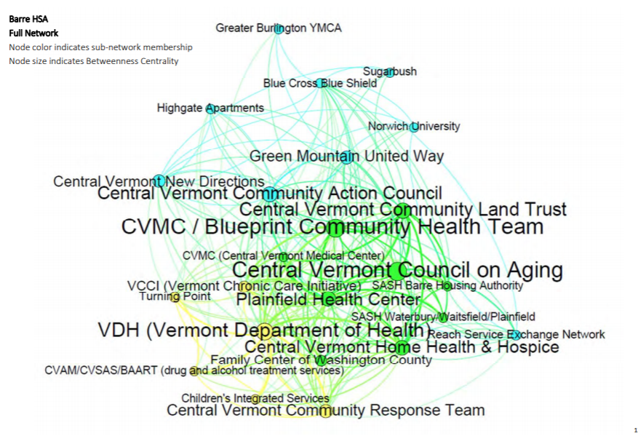
Example Network – Barre Full

Slide 14
Documents reviewed for accountability system
All Payer Model ACO Agreement
All Payer Model Implementation Improvement Plan
Act 48: An act relating to a universal unified Health system (2011/2012)
Act 79: An act relating to reforming Vermont’s mental health system (2011/2012)
Act 171: An act relating to health care reform implementation (2011/2012)
Act 54: An act relating to Health Care Financing (2013/2014)
Act 79: An act relating to health insurance, Medicaid, the Vermont Health Benefit Exchange, and the Green Mountain Care Board (2013/2014)
Act 54: An act relating to health care (2015/2016)
Act 112: An act relating to health care (2015/2016)

Slide 15
Documents reviewed for accountability system (cont.)
Act 152: An act relating to regulation of hospitals, health insurers, and managed care organizations (2015/2016)
Act 116: An act relating to health care providers participating in Vermont’s Medicaid program (2017/2018)
Act 167: An act relating to the health care regulatory duties of the Green Mountain Care Board (2017/2018)
Act 210: An act relating to miscellaneous changes to the Medicaid program and the Department of Vermont Health Access (2017/2018)
GMCB annual reports to CMS
We would like to better understand the OneCare/Provider agreements

Slide 16
Organizations Included – What Are We Missing?
GMCB
AHS (and departments)
Blueprint
CHTs
OneCare
Providers
PCPs
Hospitals
Payers (Medicaid, Medicare, Commercial)
CMS
VT State Legislature

Slide 17
Financial flows – What Are We Missing?
Objective is to understand financial flows between sectors
Hospital tax (990) forms
Exploring other non-profit tax forms

